Slide 1
Big DATA Analytics
C.RANICHANDRA
&
N.C.SENTHILKUMAR
CRA

Slide 2
NO SQL
Not Only SQL
being non-relational, distributed, open-source and horizontally scalable.
> 255 No SQL Databases
Categorized as
    Column store/column families: HBASE, Accumulo, IBM Informix
    Document Store: Azure Document DB, Mongo DB, IBM Cloudant
    Key Value/ Tuple Store: Dynamo DB, Azure Table Storage, Oracle NoSQL DB
    Graph Databases: AllegroGraph, Neo4J, OrientDB
CRA

Slide 3
NO SQL
Since 1970 , RDBMS is the only solution for data storage and manipulation and maintenance
After the data changed in all dimension(Vs), companies realized the solutions for processing big data
Solution: Hadoop, but only sequential access
CRA

Slide 4
HBase
Hbase is a distributed column-oriented database built on top of HDFS
Based on Google’s Big Table, provides random access on structured data
It’s a part of Hadoop Eco system, which provides random r/w access on HDFS
CRA

Slide 5
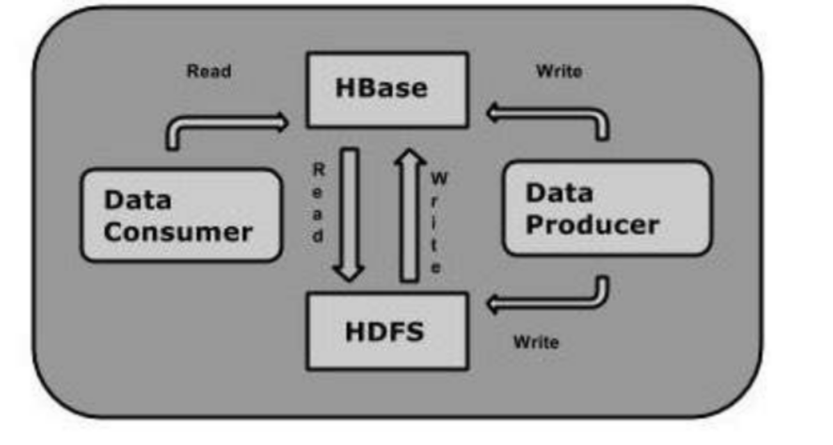
Random R/W
CRA

Slide 6
HDFS and HBASE
HDFS | HBASE
Distributed FS | Database on HDFS
Provides high latency batch processing | Low latency access to single rows
Only sequential access of data | Random access by hash index
CRA

Slide 7
Storage Mechanism in HBase
Column –oriented
Table schema defines only column families , which are key value pairs
Rowid | Column family |  |  | Column family
 | Col1 | Col2 | Col3 | Col1 | Col2 | col3
1
2
CRA

Slide 8
Hbase and RDBMS
HBASE | RDBMS
Schema less | Schema oriented
Built for wide tables, horizontally scalable | Thin and built for small tables, hard to scale
No transactions-Suitable for OLAP | Transactional
Demoralized data | Normalized data
Good for semi structured and structured data | Good for structured
CRA

Slide 9
Applications of Hbase
Need to write heavy applications
Random access of data
Facebook , twitter, yahoo and Adobe use Hbase internally
CRA

Slide 10
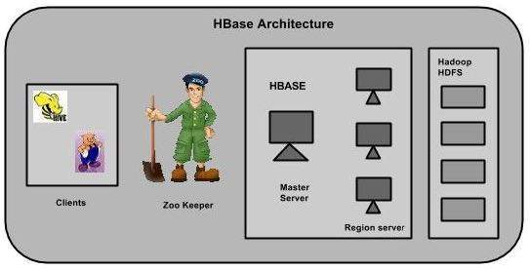
Hbase Architecture
Tables are split into regions and served by region server, Regions are divided into stores and stored in HDFS
CRA

Slide 11
HBase Shell Commands
General:
      Status
      Version
      Table_help
      Whoami
DDL:
      Create
      List
      Disable
      Is_disabled
      Enable
      Is_enabled
      Describe
      Alter
      Exists
      Drop_all –drop tables matching regrex commands
CRA

Slide 12
HBase Shell Commands
DML
  Put- a cell value
  Get- get row or cell
  Delete – delete a cell value
  Delete all- delete all the cells in a row
  Scan- scan and return table value
  Count- number of rows in a table
  Truncate- disable, drop and recreate a specified table
CRA

Slide 13
DDL
Create <table name> <family name>
List
Disable <table name>
Describe <table name>
Drop <table name>
Drop_all <regexp>
alter <tablename>, NAME=><column familyname>, VERSIONS=>5
alter <table name> , NAME =><cf> , METHOD => 'delete'
CRA

Slide 14
DML Commands
Put <'tablename'>,<'rowname'>,<'columnvalue'>, <'value'>
Scan <‘tablename’>
get 'table name', ‘rowid’, {COLUMN ⇒ ‘column family:column name ’}
delete <'tablename'>,<'row name'>,<'column name'>
deleteall <'tablename'>, <'rowname'>
truncate <tablename>
CRA

Slide 15
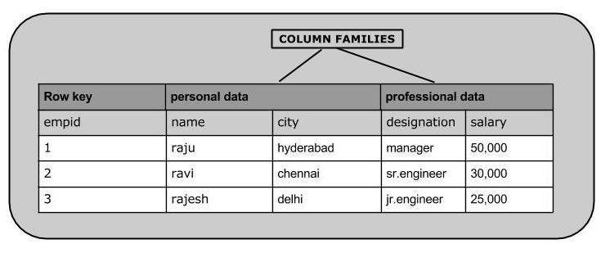
Example
CRA

Slide 16
DDL+DML Commands
  create 'emp', 'personal data', ’professional data’
put 'emp','1','personal data:name','raju‘
put 'emp','1','personal data:city','hyderabad‘
put 'emp','1','professional data:designation','manager
put 'emp','1','professional data:salary','50000’
Scan ‘emp’
CRA

Slide 17
DDL+DML Commands
get 'emp', '1‘
get 'emp', ‘1', {COLUMN ⇒ 'personal data: name'}
delete 'emp', '1', 'personal data:city‘
deleteall 'emp','1‘
put 'emp',‘1','personal data:city','Delhi‘
count 'emp‘
truncate 'emp‘
Drop ‘emp’
CRA

Slide 18
Exercise-MBA Admissions
Application no | Personal Data |  |  | Academic details
 | Name | Gender | Address | UG qualification | University/ college | Overall percentage
CRA

Slide 19
Batch Processing
Batch processing is the execution of a series of jobs in a program on a computer without manual intervention (non-interactive). Strictly speaking, it is a processing mode: the execution of a series of programs each on a set or "batch" of inputs, rather than a single input (which would instead be a custom job)
CRA

Slide 20
Batch Processing
Batch processing is very efficient in processing high volume data.
Where data is collected, entered to the system, processed and then results are produced in batches.
Here time taken for the processing is not an issue. Batch jobs are configured to run without manual intervention, trained against entire dataset at scale in order to produce output in the form of computational analyses and data files.
Depending on the size of the data being processed and the computational power of the system, output can be delayed significantly.
CRA

Slide 21
MapReduce
MapReduce is a programming paradigm that runs in the background of Hadoop to provide scalability and easy data-processing solutions.
The Map task takes a set of data and converts it into another set of data, where individual elements are broken down into tuples (key-value pairs).
The Reduce task takes the output from the Map as an input and combines those data tuples (key-value pairs) into a smaller set of tuples.
CRA

Slide 22
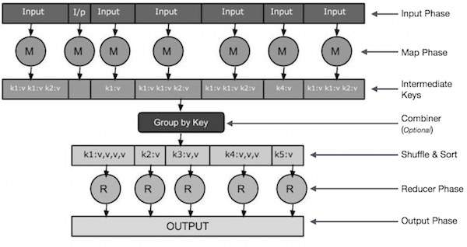
CRA

Slide 23
Phases
Input Phase − Here we have a Record Reader that translates each record in an input file and sends the parsed data to the mapper in the form of key-value pairs.
Map − Map is a user-defined function, which takes a series of key-value pairs and processes each one of them to generate zero or more key-value pairs.
Intermediate Keys − The key-value pairs generated by the mapper are known as intermediate keys.
CRA

Slide 24
Phases
Combiner − A combiner is a type of local Reducer that groups similar data from the map phase into identifiable sets. It takes the intermediate keys from the mapper as input and applies a user-defined code to aggregate the values in a small scope of one mapper. It is not a part of the main MapReduce algorithm; it is optional.
Shuffle and Sort − The Reducer task starts with the Shuffle and Sort step. It downloads the grouped key-value pairs onto the local machine, where the Reducer is running. The individual key-value pairs are sorted by key into a larger data list. The data list groups the equivalent keys together so that their values can be iterated easily in the Reducer task.
CRA

Slide 25
Phases
Reducer − The Reducer takes the grouped key-value paired data as input and runs a Reducer function on each one of them. Here, the data can be aggregated, filtered, and combined in a number of ways, and it requires a wide range of processing. Once the execution is over, it gives zero or more key-value pairs to the final step.
Output Phase − In the output phase, we have an output formatter that translates the final key-value pairs from the Reducer function and writes them onto a file using a record writer.
CRA

Slide 26
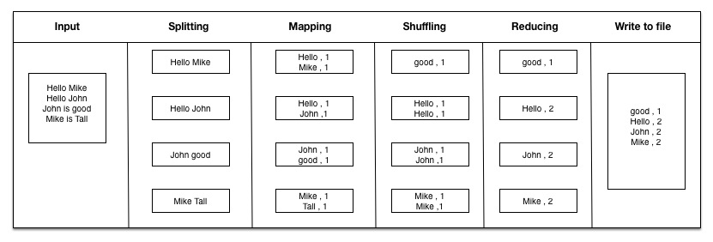
Word Count Example
CRA

Slide 27
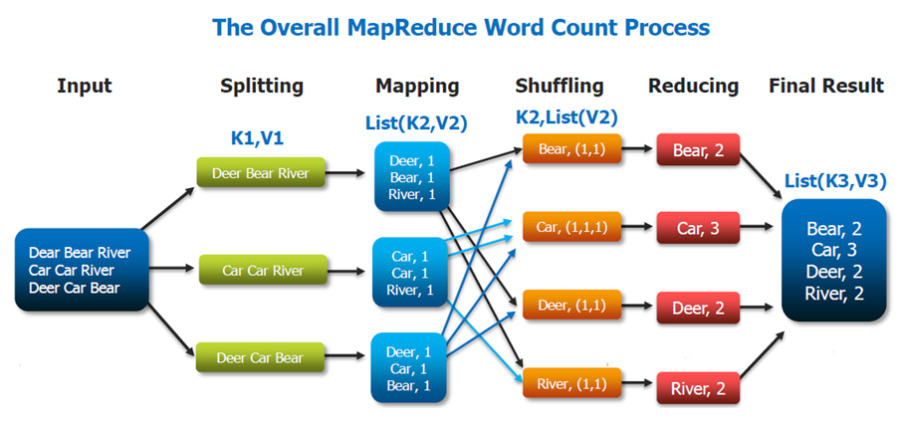

Slide 28
Anatomy of MapReduce
MapReduce 1 (classic)
MapReduce 2 (YARN)
hadoop>start-dfs.sh
  Starting namenode, datanode, secondary namenode
hadoop>jps
  Jobid Namenode,secondary namenode(m)
  Jobid Datanode (s)
hadoop>start-yarn.sh
  Starting resource manager(m), node manager(c)
hadoop>jps
  Jod id Resource Manager(m),
  Job id Node Manager(s)
CRA

Slide 29
Execute wordcount
Hadoop> hadoop jar wordcount.jar
–input /usr/local/hadoop/input/4800-4.txt
  –output /usr/local/hadoop/output
CRA

Slide 30
Classic MapReduce Framework
Four Entities
  The client-submit job
  The Job Tracker –coordinates the job, a Java API-JobTracker main class
  The task Tracker-run the task that the job has been split, TaskTracker main class
  Distributed file system for sharing files between entiites
CRA

Slide 31
Job Submission
Asks jobtracker for a new jobID
Checks the output directory[error : not specified or already exists]
Computes the input splits [error: if input path does not exist or file very small]
Copies the resources needed to run the job[JAR file,configuration file,input splits] to jobtracker file system
Tells the jobtracker that the job is ready for exec . By calling submitjob( )
CRA

Slide 32
Job Initialization
Jobtracker puts job in internal queue
Job scheduler picks the job
Job scheduler initializes the job by creating a object( encapsulates tasks and book keeping information)
One map task for each split
Number of reducer –mapred.reduce.tasks
Plus setup task, cleanup task –run by task tracker
CRA

Slide 33
Task Assignment
Task tracker run a simple loop that periodically send heart beat to job tracker
Indicates whether ready to run a task
Fixed slots for map task and reduce task[default 2]
Task tracker for map is chosen for how close it is to input splits [data-local or rack –local]
For reduce – next in list
CRA

Slide 34
Task Execution and Job Completion
Jar and other supporting files from shared FS is localized
Creates instance of Taskrunner to run the task
Jobtracker receives that the last task is over-clean up task-job is successful
CRA

Slide 35
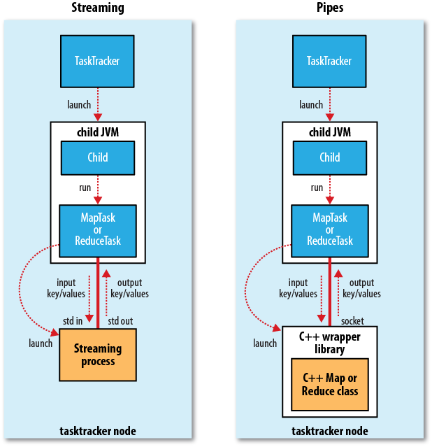
CRA
09/07/16

Slide 36
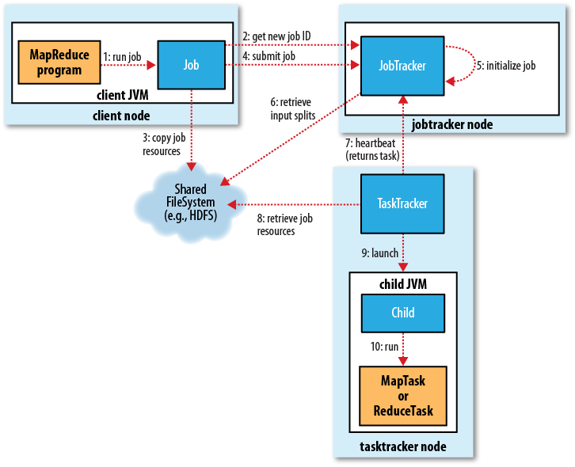
NO SQL
CRA

Slide 37
YARN MapReduce 2
For large clusters -4000 nodes
YET Another Resource Negotiater
Remedies the scalability of classic by splitting role of job tracker- Resource manager and application manager
CRA

Slide 38
Entities
Client-job submission
Resource manager- coordinates the allocation of resources on cluster
Node Manager- monitor machines in cluster
Application Master- coordinates the tasks running the MapReduce job
HDFS
CRA

Slide 39
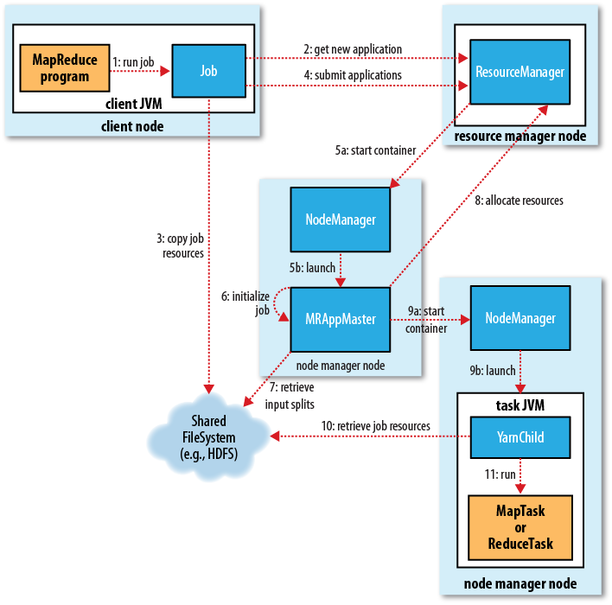
CRA

Slide 40
Failures in YARN
Modes- task, application master, node manager, resource manager
Task- same as classic
Application master failure- applications in YARN are tried multiple times in the event of failure, Resource manager will detect the failure and start in new container
Node Manager failure- node manager sends periodic heart beat to resource manager, so RM will detect the failure and remove from list
CRA

Slide 41
Node manager-will be black listed , if the failures of application is high
Resource Manager Failure-serious, recover from crashes by using check point mechanism
CRA

Slide 42
Job Scheduling
Early versions of hadoop- FIFO, Queue based, priorities added , but no preemption, high priority jobs wait for long running jobs
Later verions
  The Fair Scheduler-each user a fair share of the cluster capacity, single job all nodes in the cluster, m jobs n nodes form the cluster. Jobs are placed in pools. Supports preemption . If a pool has not received its fair share, scheduler will kill tasks in one pool and give to other
  Contrib module, place the jar in hadoop classpath by copying from contrib/fairscheduler and set the property
  org.apache.hadoop.mapred.FairScheduler
CRA

Slide 43
  The Capacity Scheduler-cluster is made up of a number of queues, which is hierarchical, each q has allocated capacity. Within each q jobs are scheduled using FIFO (with priorities)
CRA

Slide 44
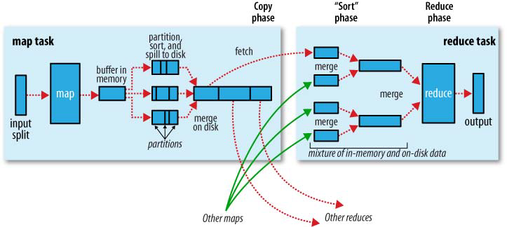
Shuffle and Sort
CRA
09/07/16

